Slide 1

History
of the Universe
(a current view)

Slide 2
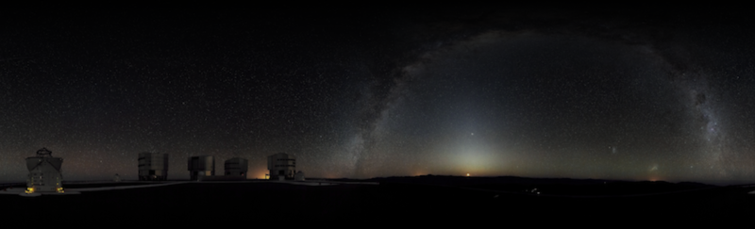
Review
What fuels a main sequence star?
Which type of stars turn into white dwarfs?
What is the difference between a nebula and a planetary nebula?
What is a red giant?
What does a H-R diagram show?
‘360-degree Panorama of the Southern Sky’
by European Southern Observatory. CC-BY-3.0,
commons.wikimedia.org/wiki/
File:360-degree_Panorama_of_the_Southern_Sky_edit.jpg
Notes:
Slide notes
Cosmology is the scientific study of large-scale properties of the Universe as a whole. It endeavors to use the scientific method to understand the origin, evolution and ultimate fate of the Universe. Like any field of science, cosmology involves the formation of theories or hypotheses that make specific predictions for phenomena that can be tested by observations. Depending on the outcome of such observations, theories may be abandoned, revised or extended to accommodate data.

Slide 3
Learning Intentions
The universe contains features including galaxies, stars and solar systems and the Big Bang theory can be used to explain the origin of the universe
recognising that the age of the universe can be derived using knowledge of the Big Bang theory
describing how the evolution of the universe, including the formation of galaxies and stars, has continued since the Big Bang
‘360-degree Panorama of the Southern Sky’
by European Southern Observatory. CC-BY-3.0,
commons.wikimedia.org/wiki/
File:360-degree_Panorama_of_the_Southern_Sky_edit.jpg
Notes:
Slide notes
Cosmology is the scientific study of large-scale properties of the Universe as a whole. It endeavors to use the scientific method to understand the origin, evolution and ultimate fate of the Universe. Like any field of science, cosmology involves the formation of theories or hypotheses that make specific predictions for phenomena that can be tested by observations. Depending on the outcome of such observations, theories may be abandoned, revised or extended to accommodate data.

Slide 4
Success Criteria
Summarise the Big Bang Theory
Define and describe singularity
Use an analogy or model to explain the expansion of the universe
List 4 fundamental interactions
Explain why the universe has cooled as it expanded.
‘360-degree Panorama of the Southern Sky’
by European Southern Observatory. CC-BY-3.0,
commons.wikimedia.org/wiki/
File:360-degree_Panorama_of_the_Southern_Sky_edit.jpg
Notes:
Slide notes
Cosmology is the scientific study of large-scale properties of the Universe as a whole. It endeavors to use the scientific method to understand the origin, evolution and ultimate fate of the Universe. Like any field of science, cosmology involves the formation of theories or hypotheses that make specific predictions for phenomena that can be tested by observations. Depending on the outcome of such observations, theories may be abandoned, revised or extended to accommodate data.

Slide 5
The Big Bang theory
Discoveries in astronomy and physics suggest that the Universe had a definite beginning.
The Big Bang theory is the prevailing theory that describes the origin and evolution of the Universe.
It is considered to be our best theory of cosmology because it explains most experimental observations.
‘360-degree Panorama of the Southern Sky’
by European Southern Observatory. CC-BY-3.0,
commons.wikimedia.org/wiki/
File:360-degree_Panorama_of_the_Southern_Sky_edit.jpg
Notes:
Slide notes
Cosmology is the scientific study of large-scale properties of the Universe as a whole. It endeavors to use the scientific method to understand the origin, evolution and ultimate fate of the Universe. Like any field of science, cosmology involves the formation of theories or hypotheses that make specific predictions for phenomena that can be tested by observations. Depending on the outcome of such observations, theories may be abandoned, revised or extended to accommodate data.

Slide 6
What was the Big Bang?
About 13.7 billion years ago, the entire Universe was compressed into a singularity – a place with zero volume and infinite density.
Matter, energy, space and time all began inside the singularity.
At the moment of the Big Bang, the Universe started to expand, cool and become less dense.
The Universe is still expanding today.
Notes:
Slide notes
Big Bang theory is a broadly accepted model for the origin and evolution of the Universe. It postulates around 12 to 14 billion years ago the portion of the Universe we can see today was compressed into a singularity only a few millimetres across. The Universe has since expanded from this hot dense state into the vast and much cooler cosmos we currently inhabit.
The best available measurements, as of 2011, suggest that the Big Bang occurred between 13.3 and 13.9 billion years ago.
Big Bang theory doesn’t attempt to explain how the singularity came into existence, or what gave rise to the Big Bang.
If students ask what happened before the Big Bang, the conventional answer is that there is no such thing as ‘before the Big Bang’. The Big Bang is the event that started everything, including time. But the right answer, says physicist Sean Carroll, is “We just don’t know.”
Source: http://www.universetoday.com/15051/thinking-about-time-before-the-big-bang/

Slide 7

What the Big Bang wasn't
The Big Bang wasn't an explosion that happened somewhere in space.
The Universe didn't appear somewhere in space.
The Big Bang created space and time.
Notes:
Slide notes
The Big Bang was the beginning of the Universe as we know it.

Slide 8



What is an expanding Universe?
Galaxies move apart because space itself is expanding.
They are not moving apart because of some past explosion.
Notes:
Slide notes
The Universe didn’t expand into anything, because there wasn’t anything for it to expand into. Everything, including space itself, was created in the Big Bang. The Universe expanded because the space between the galaxies expanded.
• To the galaxies, there is no centre from which expansion occurred. Expansion from a central point could only be evident to an observer ‘outside the Universe’ (but we don’t know that there is such a place).
• Cosmologists believe that Dark Energy is causing the Universe to expand. This is discussed further in the SPICE resource, Cosmology 3: The future of the Universe.

Slide 9

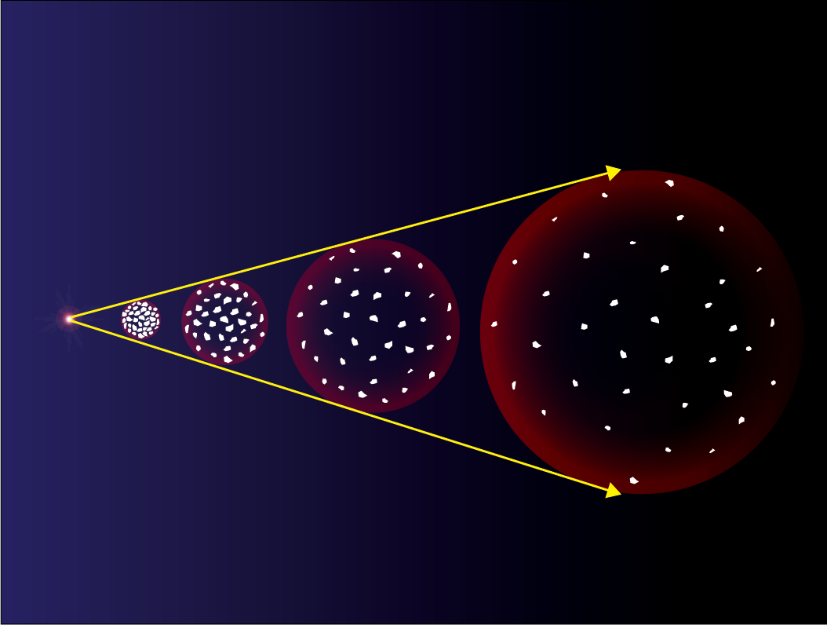
Expansion of the Universe
Galaxies move apart as the Universe expands.

Slide 10
The beginning of the Universe
Big Bang theory doesn't attempt to explain why the Universe was created, or what (if anything) might have existed before it.
Our ideas about the very early Universe are, at best, speculative.
The first 10⁻⁴³ seconds of the Universe is called the Planck era. Conditions were so extreme that we suspect quantum behaviour was dominant, including quantum gravity.
We don't yet have a theory of quantum gravity, but we do have theories that explain what happened from this time on.
Notes:
Slide notes
The Planck era (the first 10⁻⁴³ seconds after the Big Bang) is the earliest period in the history of the Universe during which quantum effects of gravity were significant. Planck time (approximately 10⁻⁴³ s) is thought to be the shortest interval of time that could be measured.
As of 2010, the shortest time interval measured directly was about 10⁻¹⁷ s (about 10²⁶ Planck times).
Research into the timeline of events that followed the Big Bang provides a range of responses, which while generally supporting a consistent sequence of events, frequently differ in their timing — especially during the first 10 seconds or so. This presentation has drawn together information from a number of sources into the sequence presented in http://en.wikipedia.org/wiki/Timeline_of_the_Big_Bang.

Slide 11
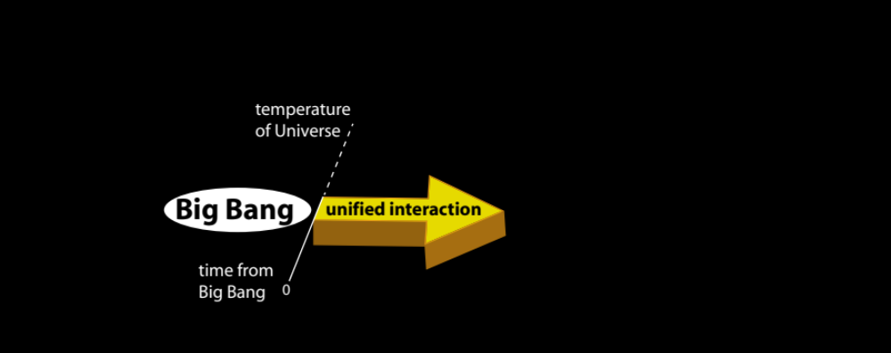
Fundamental interactions
All forces in the Universe can be attributed to four fundamental interactions between particles.
Physicists believe that all known interactions were unified at the moment of the Big Bang.
Shortly after the Big Bang, this unified interaction began to separate into gravitational, strong, weak and electromagnetic interactions.
Notes:
Slide notes
Any force you can think of, whether it’s friction, magnetism, gravity, or nuclear decay, is caused by one of the four fundamental interactions - gravity, electromagnetism, the strong and the weak interactions.
• Gravity is an interaction that exists between all matter in the Universe.
• Electromagnetism determines how electrically charged particles interact with each other and with magnetic fields.
• The strong interaction holds quarks together in protons and neutrons. Residual strong interactions hold the nuclei of atoms together by overcoming electrostatic repulsion between protons.
• The weak interaction is responsible for radioactive decay of some nuclei by controlling the beta decay process in which neutrons split into protons, electrons, and antineutrinos.
The difference between a force and an interaction:
A force is the effect on a particle (attraction, repulsion) due to the presence of other particles.
An interaction includes all the forces that affect a particle and any decays and annihilations that it may experience.
While some interactions give rise to conventional forces they don’t always do so. For example, the weak interaction never gives rise to forces – it simply mediates nuclear decay. Similarly, the electromagnetic interaction sometimes is responsible for phenomena that aren’t forces, such as when an electron and a positron annihilate resulting in two photons.

Slide 12

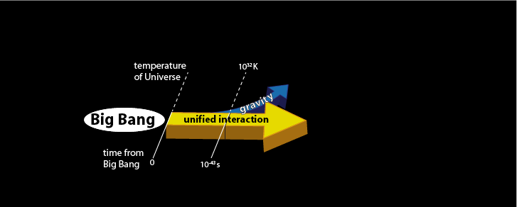
Fundamental interactions
10⁻⁴³ seconds after the Big Bang, gravity separated from the unified interaction.
10³²K
Notes:
Slide notes
10⁻⁴³ seconds after the Big Bang, gravity separated from the unified interactions. The Grand Unified Theory (GUT) describes the interactions between electromagnetism, the strong and the weak interactions.

Slide 13
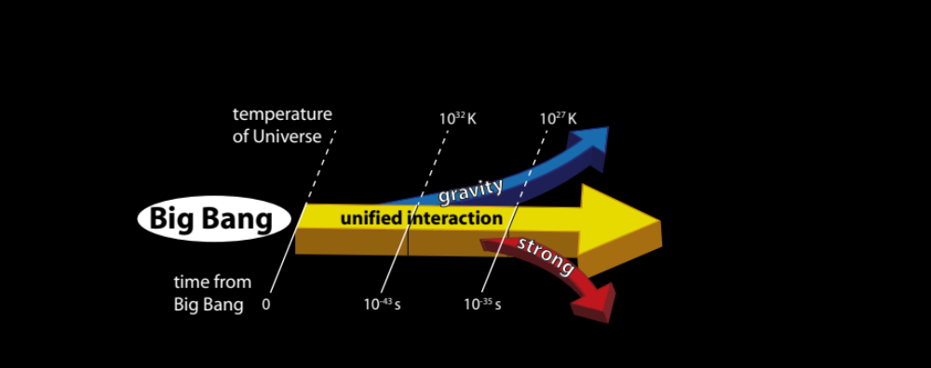
Fundamental interactions
10³²K
10⁻³⁵ seconds after the Big Bang, the strong interaction separated.
This released a vast amount of energy, making the Universe expand at an extraordinary rate.
10³²K
10²⁷K
Notes:
Slide notes
The GUT era ended when the strong interaction separated from the electromagnetic and weak interactions, 10⁻³⁵ seconds after the Big Bang. Separation of the strong interaction set off a rapid expansion (inflation) of the Universe.
The Inflation theory was developed in the 1980s to explain how very distant parts of the Universe could once have been in close contact. It proposes that the linear size of the Universe expanded by a factor of 10²⁵ in a fraction of a second. Inflation theory is considered to be an extension of Big Bang Theory.

Slide 14
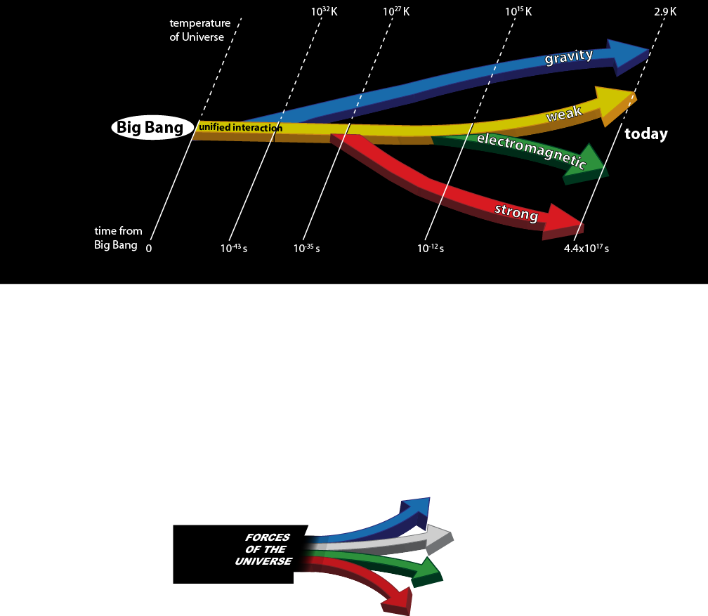
Fundamental interactions
10⁻¹² seconds after the Big Bang, the electromagnetic and the weak interactions separated. The four fundamental interactions were now distinct, as they remain to this day.
10²⁷K
10¹⁵K
Notes:
Slide notes
10⁻¹² seconds after the Big Bang, the final separation occurred. The four fundamental interactions were now distinct, as they remain to this day.

Slide 15
The evolution of matter
quark era | 10⁻¹² – 10⁻⁶ seconds after the Big Bang
hadron era | 10⁻⁶ – 1 second after the Big Bang
lepton era | 1 sec – 10 seconds after the Big Bang
radiation era | 10 sec – 300 000 years after the Big Bang
Notes:
Slide notes
For further information on the Standard Model and sub-atomic particles, including hadrons, quarks, leptons, neutrinos and a range of anti-particles, see the SPICE resource, Matter and relativity 1: Quarks.

Slide 16
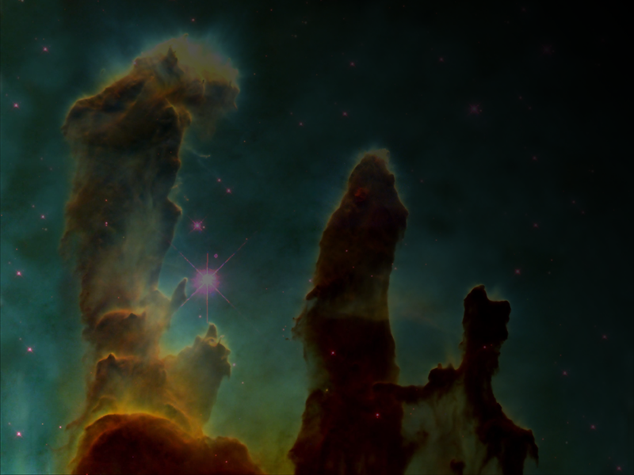
The formation of stars
Over the next 100 million years or so, the Universe continued to expand and cool.
Gravitational variations caused matter to clump together and become hotter and denser.
100–200 million years after the Big Bang, matter began to coalesce and form stars.
Fusion of light elements in stars released energy and formed elements from carbon to iron.
‘Eagle nebula pillars’ from NASA/ESA
http://commons.wikimedia.org/wiki/File:Eagle_nebula_pillars_complete.jpg
100K

Slide 17
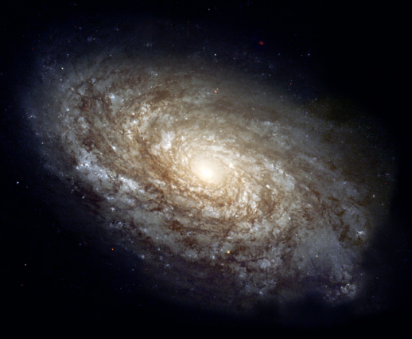
The formation of galaxies
A billion years after the Big Bang, stars grouped to form galaxies.
Galaxies formed clusters.
NGC 4414, a typical spiral galaxy in the constellation Coma Berenices.
NASA/ESA, http://en.wikipedia.org/wiki/File:NGC_4414_%28NASA-med%29.jpg

Slide 18
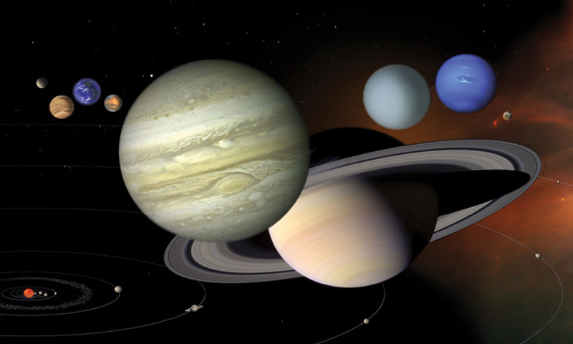
Formation of the Solar System
8.4 billion years after the Big Bang (4.5 billion years ago), the Solar System began to form from the collapse of a giant gas cloud.
‘Our Solar System’ by NASA/JPL, PD-USGOV
solarsystem.nasa.gov/multimedia/display.cfm?IM_ID=10164

Slide 19

Humans appear on Earth
13.7 billion years after the Big Bang, human life
began on Earth.
3K

Slide 20
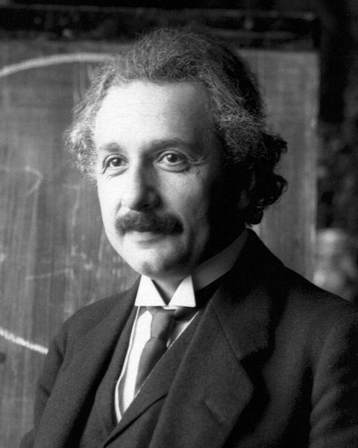
"The most incomprehensible thing about the Universe is that it is comprehensible."
Albert Einstein, 1935
photo by Ferdinand Schmutzer,
commons.wikipedia.org/
wikiFile:Einstein1921_by_F_Schmutzer_2.jpg

Slide 21
Success Criteria
Summarise the Big Bang Theory
Define and describe singularity
Use an analogy or model to explain the expansion of the universe
List 4 fundamental interactions
Explain why the universe has cooled as it expanded.
‘360-degree Panorama of the Southern Sky’
by European Southern Observatory. CC-BY-3.0,
commons.wikimedia.org/wiki/
File:360-degree_Panorama_of_the_Southern_Sky_edit.jpg
Notes:
Slide notes
Cosmology is the scientific study of large-scale properties of the Universe as a whole. It endeavors to use the scientific method to understand the origin, evolution and ultimate fate of the Universe. Like any field of science, cosmology involves the formation of theories or hypotheses that make specific predictions for phenomena that can be tested by observations. Depending on the outcome of such observations, theories may be abandoned, revised or extended to accommodate data.

Slide 22
© 2011 The University of Western Australia
ast0702, v1.0
for conditions of use see spice.wa.edu.au/usage

